Slide 1
The Last Lecture
CS 5010 Program Design Paradigms
"Bootcamp"
Lesson 12.1
© Mitchell Wand, 2012-2017
This work is licensed under a Creative Commons Attribution-NonCommercial 4.0 International License.

Slide 2
The Point
1. It’s not calculus. Getting the right answer is not enough.
2. The goal is to write beautiful programs.
3. A beautiful program is one that is readable, understandable, and modifiable by people.

Slide 3
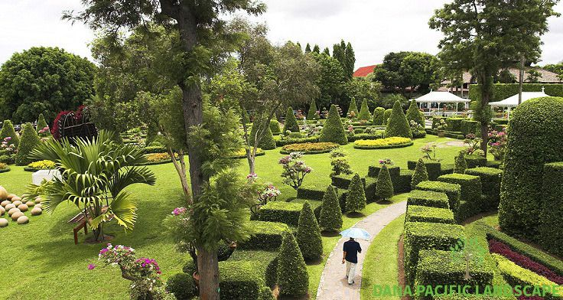
Your programs should look like this:
source

Slide 4
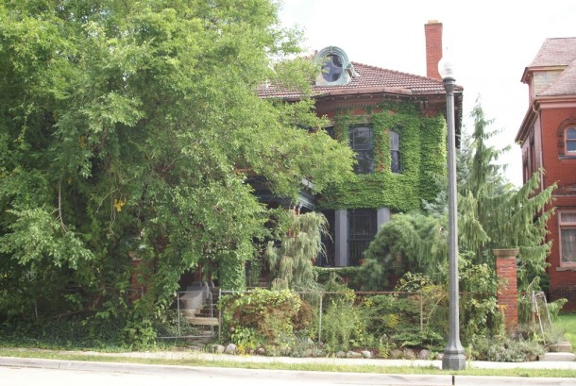
Not like this
source

Slide 5
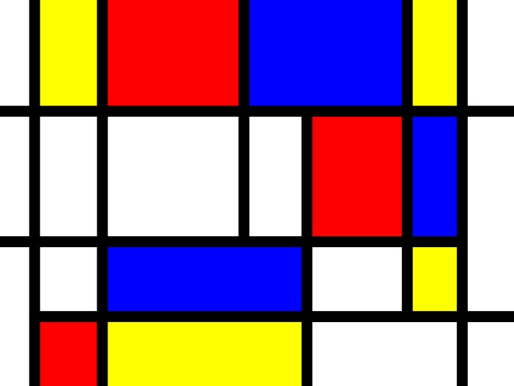
Your programs should look like this
source

Slide 6
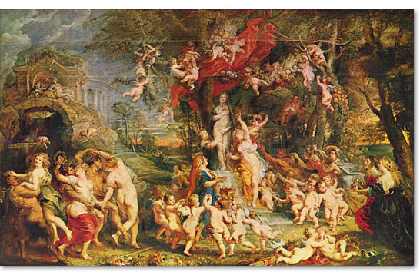
Not like this
source

Slide 7
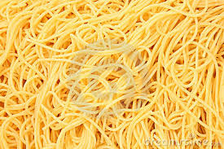
And never, ever like this
source

Slide 8
Key Practices for writing beautiful programs
1. Write programs that people can read, understand, and modify.
2. Represent information as data; interpret data as information.
3. Use contracts and purpose statements to specify the intended behavior of your functions and methods.
4. Use invariants to limit your functions’ responsibility.
5. Use functions and methods that produce and consume values.
6. Use state only to share information between distant parts of the program.
7. Use interfaces to limit dependencies between different parts of your program.

Slide 9
1. Write programs that people can read, understand, and modify
You write programs so others can read them
Bosses, customers, maintainers, etc.
This means an older version of you, too
You work with others as you develop programs
The earlier you articulate your thinking, the earlier you can catch flaws
The earlier you catch flaws, the easier/cheaper they are to fix

Slide 10
2. Represent Information as Data; Interpret Data as Information
representation
Information
Data
interpretation
If you don’t know what your data means, you can’t possibly manipulate it correctly!

Slide 11
3. Use contracts and purpose statements to specify the intended behavior of your functions and methods
Writing out the contract and purpose statement before you code will help you plan.
The person who calls your function should never have to read your implementation to figure out what your function returns.
If you use good function names, the reader will have a good head start.
If you don’t know what your function is supposed to do, how can you possibly write it?
If the reader doesn’t know what your function is supposed to do, how can they possibly understand your code?

Slide 12
4. Use Invariants to Limit Your Function's Responsibility
Your function may need to rely on information that is not under its control and not represented in its contract.
Record this assumption as an invariant (WHERE clause).
The function is only responsible for giving the right answer for inputs that satisfy the invariant.
The caller is responsible for making sure that the invariant is satisfied.

Slide 13
5. Use functions and methods that produce and consume values
Functional model makes it easy to create examples and test data
Easier to understand
Easier to test
You can test your functions independently, without worrying about the order of the tests.
Your function shouldn’t have side-effects unless that’s its purpose.

Slide 14
6. Use state only to share information between distant parts of the program.
You need to use state in exactly two situations:
you need an object with stable identity to send messages to or ask questions of (e.g. the players)
you need to construct cyclic structures
Sometimes you need state, but less often than you might think
Java, C++, etc. lead you to use state more often than you should.

Slide 15
7. Use interfaces to limit dependencies between different parts of your program.
Always manipulate your data through a set of functions.
That way, if you change the representation of your data, you won’t have to change other parts of your program.

Slide 16
Other important things to remember...

Slide 17
The Function Design Recipe
The Function Design Recipe
1. Data Design
2. Contract and Purpose Statement
3. Examples and Tests
4. Design Strategy
5. Function Definition
6. Program Review
Remember, this is a process, not a set of deliverables.
Notes:
Here is the function design recipe.

Slide 18
The Shape of the Program Follows the Shape of the Data
BinTree
tree-fn
is-component-of
calls
leaf data
leaf data function
Data Hierarchy (a BinTree is either leaf data or has two components which are BinTrees
Call Tree (tree-fn either calls a function on the leaf data, or it calls itself twice.)

Slide 19
Design one function/method per task
Small is good. Period.
Big is bad. Period.
If you have complicated junk in your function, you must have put it there for a reason. Turn it into a separate function so you can test it.
If you can’t think of a good name for your help function, then you are probably doing it wrong.

Slide 20
Don't Repeat Yourself
Introduce a generalization whenever you start to duplicate code.
Any time you copy & paste, look for a pattern.
One is an exception; two is a coincidence; three is a pattern.
But don't generalize until you know what the pattern is.
It's OK to copy & paste for a while until you see the pattern. But be sure to replace them all with good generalizations. Your testers and maintainers will thank you.

Slide 21
Don't Reinvent the Wheel
Use other people’s code, libraries, etc. whenever possible (and legal).
You aren’t (or shouldn’t be) paid by the line!

Slide 22
Summary: You need never be afraid of this:
You need never be afraid of a blank page.

Slide 23
You know the questions to ask
What is the relevant information from the world?
How should it be represented as data?
What is the purpose of this system/function/method?
How should I go from purpose to code?

Slide 24
And you know how to write down the answers
Data Definitions and Interpretations
Contracts and Purpose Statements
Examples and Tests
Design Strategies
Code

Slide 25
Go get ‘em!!
And good luck!
Stay in touch.
--Prof. Wand

